Slide 1

Project 2: Business Fluctuations
Economic Fluctuations & Firm-Level Responses
Cross-Country Analysis, Crisis Event Study and Firm Insights
Ravindu Weerasekara

Slide 2

Cross-Country Business Cycle Analysis
USA, France and Australia (2005-2024)

Slide 3
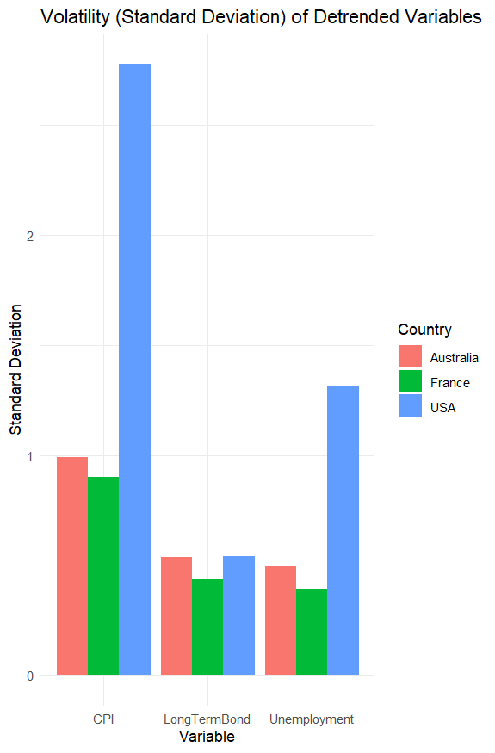
Volatility Analysis: USA vs. Global Peers
High Price Volatility (USA): The US exhibits exceptionally high CPI volatility (Std. Dev. ≈ 2.8), nearly triple that of Australia or France.
Labor Market Swings: US unemployment is significantly more volatile (Std. Dev. ≈ 1.3), indicating a "hire and fire" labor market dynamic.
Financial Integration: Long-term bond yields show uniform, low volatility across all three nations, reflecting global financial integration.
Takeaway: The US economy is characterized by sharper domestic cyclical swings compared to the stability of France and Australia.

Slide 4
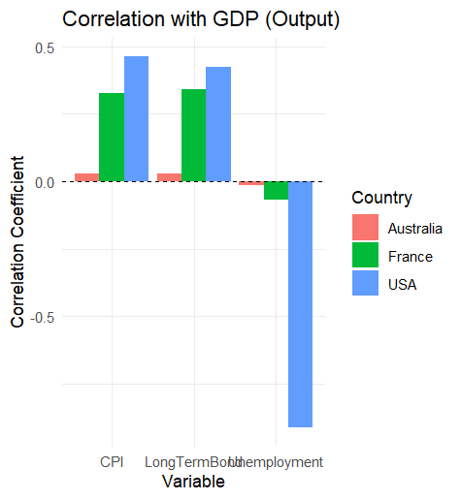
Correlation with Output (GDP)
USA ("Textbook Cycle"):
Procyclical: Inflation and Interest Rates rise with GDP.
Countercyclical: Unemployment strongly falls as GDP rises (Corr ≈ -0.8).
France (Muted): Follows a similar pattern to the US but with a much weaker link between output and unemployment.
Australia (The Anomaly): Key variables are acyclical (near zero correlation), suggesting its cycle is driven by external factors like commodity prices rather than domestic demand.

Slide 5
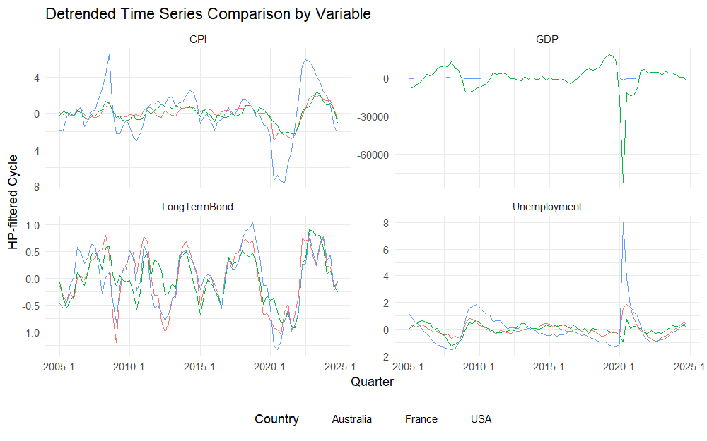
Cyclical Dynamics Over Time
Global Financial Crisis (2008): Visible as a synchronized dip in GDP across all three nations.
COVID-19 (2020) Divergence:
France: Experienced a catastrophic and
immediate drop in GDP, exceeding peers.
USA: Saw an unprecedented, historic spike in unemployment, far larger than any prior event.
Visual Confirmation: The "spikiness" of US time series data confirms the high volatility findings.

Slide 6
Event Study: GFC vs. COVID-19 in the USA
Comparative Analysis of Two Crises

Slide 7
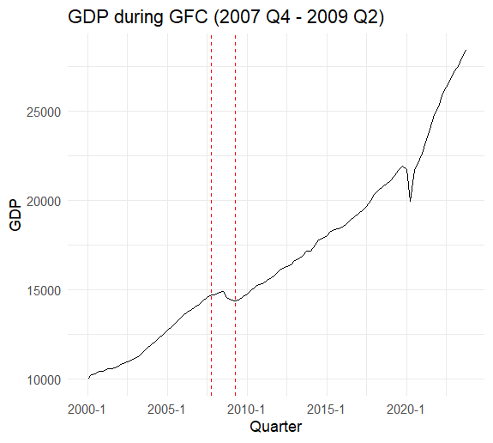
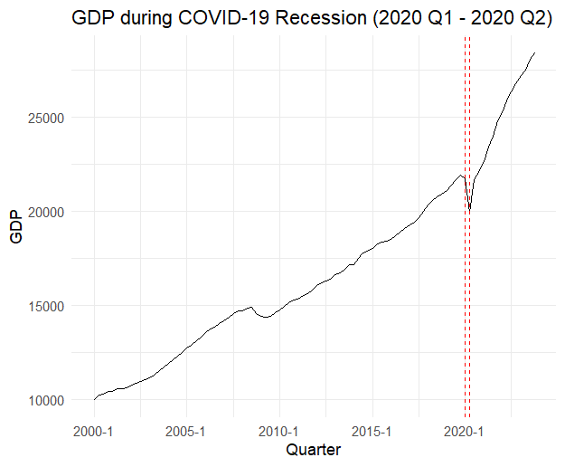
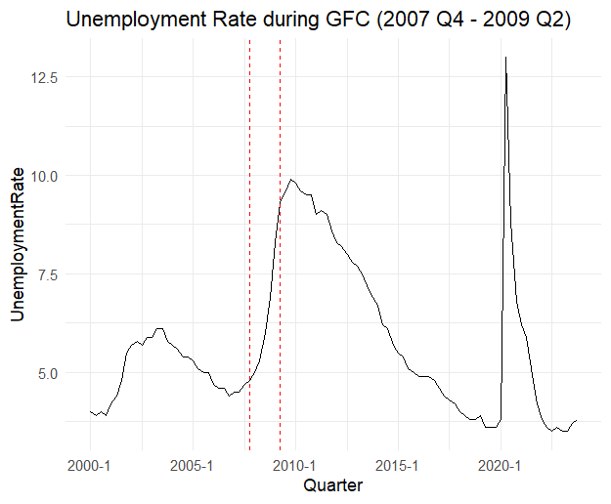
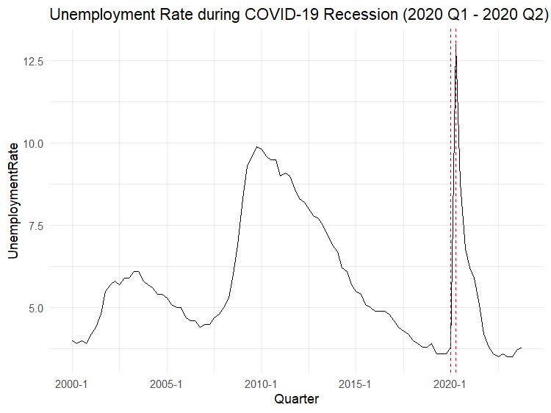
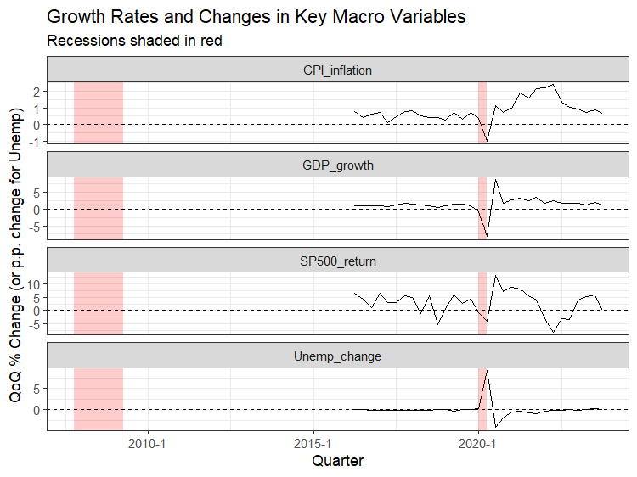
Macro Dynamics: A Tale of Two Crises
Real GDP:
GFC: A prolonged "U-shape" contraction.
COVID-19: A sharp, sudden "V-shape" drop and rebound.
Unemployment: The GFC was a "slow burn" where unemployment peaked years later. COVID-19 saw a single, massive spike followed by rapid improvement.
Financial Markets (S&P 500): The GFC endured a multi-year bear market, while COVID-19 was a brief panic followed by a bull run.

Slide 8





Severity of the Shock- COVID 19
GDP Collapse
Job Losses
Nature of Shock
COVID-19: GDP plummeted nearly
-9% in a single quarter, dwarfing the worst quarter of the GFC (-2.5%).
Unprecedented: Unemployment spiked by over 5 percentage points in one quarter, a speed never seen in modern history.
Exogenous: Unlike the endogenous financial rot of the GFC, COVID-19 was a "sudden stop" imposed by external health factors.

Slide 9
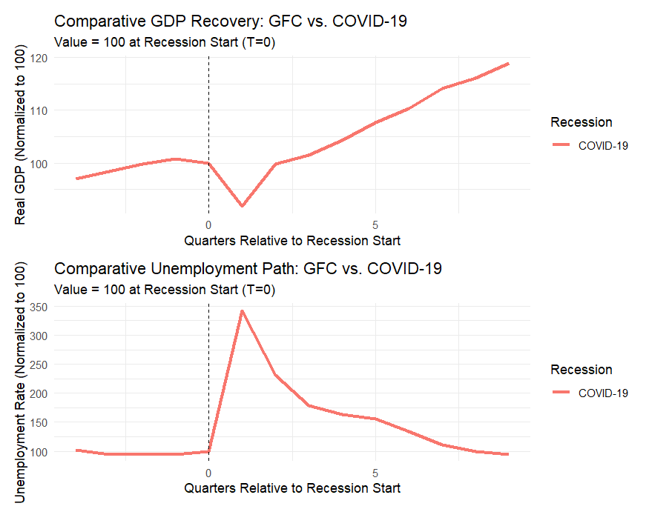
Recovery Paths: U-Shape vs. V-Shape
GFC (The U-Shape):
COVID-19 (The V-Shape):
Conclusion: Economic output recovered its pre-recession level significantly faster in 2020 than in 2009.

Slide 10
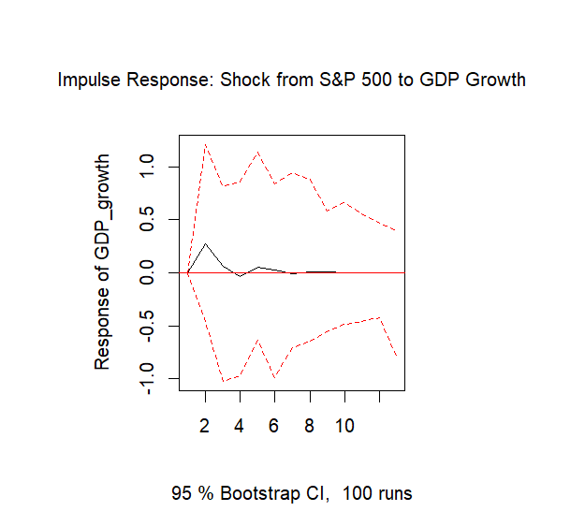
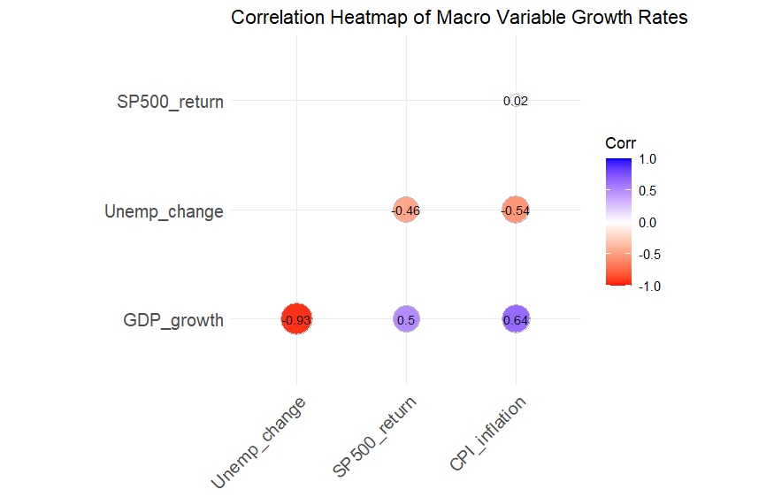
Shock Propagation Mechanism
Financial to Real Amplification: Analysis confirms that shocks to the S&P 500 significantly impact Real GDP growth.
Wealth Effects: Rising markets make consumers feel richer, boosting spending. Falling markets do the reverse.
Confidence Channel: Firms use market signals to gauge future demand. A market collapse (like in the GFC) causes firms to freeze investment.

Slide 11
Firm-Level Responses to the GFC
Evidence from Compustat Data

Slide 12
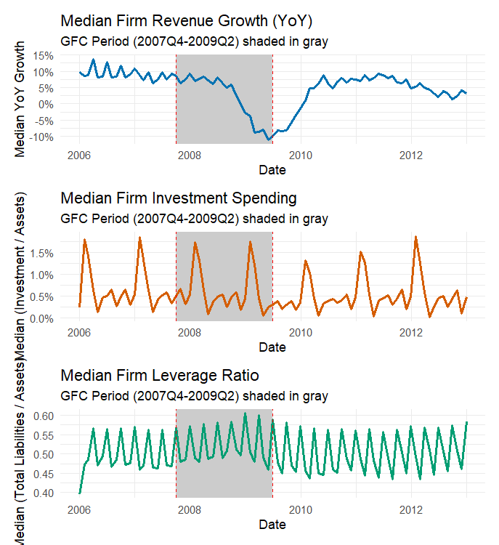
Aggregate Firm Performance
Revenue Shock: Median firm revenue dropped ≈10% due to the collapse in aggregate demand.
Investment Freeze: Widespread cuts in capital expenditure (CAPEX) as firms conserved cash amidst uncertainty.
Leverage Spike :median leverage ratio jumping from about 0.50 pre-crisis to nearly 0.60 as falling asset values mechanically inflated leverage and deepened the recession by forcing firms to cut investment and hiring.

Slide 13
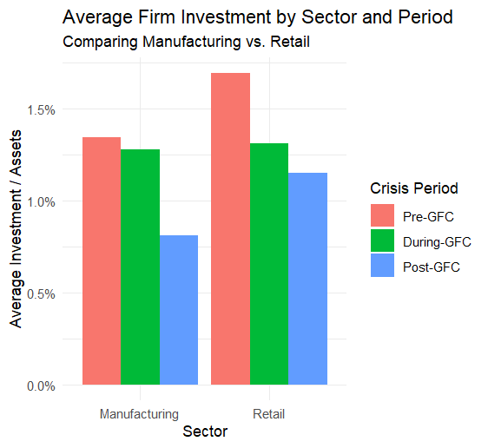
Sectoral Heterogeneity
Retail (Immediate Impact): Highly sensitive to consumer demand, retail firms cut investment immediately as the crisis hit.
Manufacturing (Delayed Impact): was stable during the crisis, collapsed after the crisis, falling to 0.8%
Insight: Capital-intensive sectors face "lumpy" adjustments and long-term uncertainty, leading to persistent post-crisis drags on growth.

Slide 14
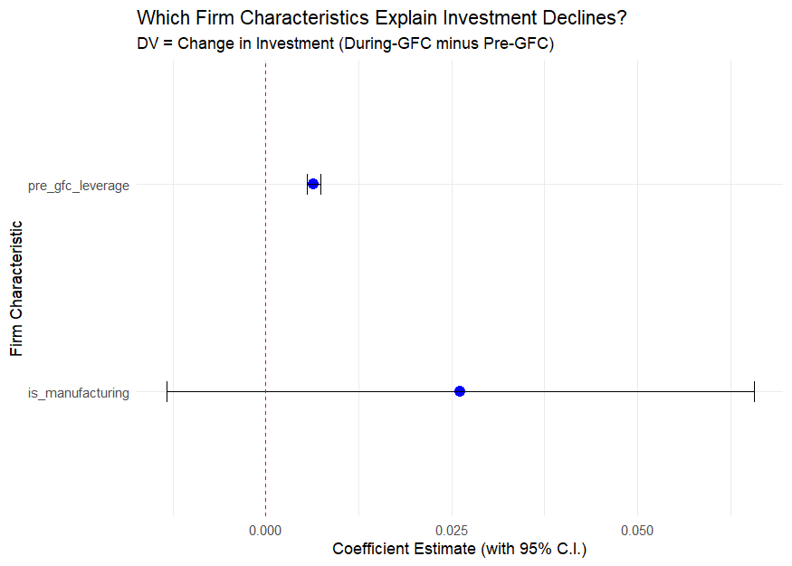
What Drove Investment Cuts?
Regression Analysis: Explaining the change in investment rates (During-GFC minus Pre-GFC).
Manufacturing Resilience: Being in manufacturing was associated with a smaller investment decline during the acute phase.
The Leverage Puzzle: Higher-leverage firms unexpectedly cut investment less during the crisis.

Slide 15





Summary & Key Takeaways
Distinct Cycles
Crisis Nature
Firm Behavior
Economies are structurally different. The US is a high-volatility engine, while Australia remains an acyclical anomaly driven by external factors.
The nature of the shock determines the recovery. Financial shocks (GFC) create slow U-shaped recoveries; external shocks (COVID) allow for rapid V-shaped rebounds.
Firms react heterogeneously. The "denominator effect" drives leverage spikes, and investment cuts vary significantly by sector and pre-existing financial conditions.

Slide 16
Thank You.!

